Slide 1
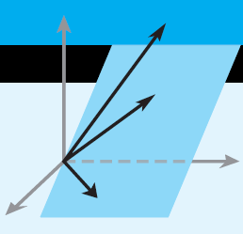
Elementary Linear Algebra
Howard Anton
Copyright © 2010 by John Wiley & Sons, Inc.
All rights reserved.
Chapter 4
Notes:
*

Slide 2
Chapter 4
General Vector Spaces
4.1 Real Vector Spaces
4.2 Subspaces
4.3 Linear Independence
4.4 Coordinates and Basis
4.5 Dimension
4.6 Change of Basis
Notes:
*

Slide 3
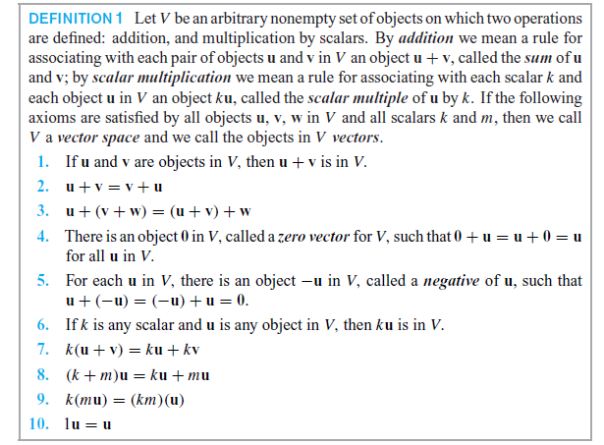
Section 4.1 Vector Space Axioms
Notes:
*

Slide 4

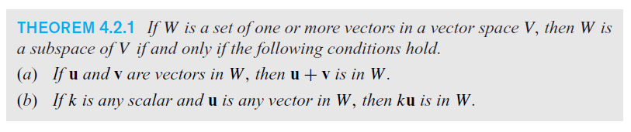
Section 4.2 Subspaces
Notes:
*

Slide 5
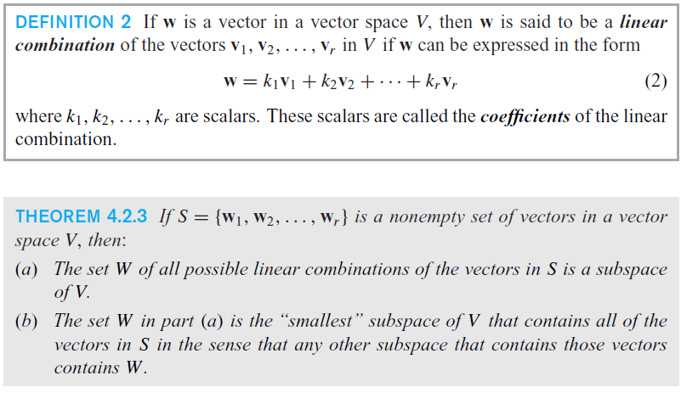
The ‘smallest’ subspace of a vector space V
Notes:
*

Slide 6
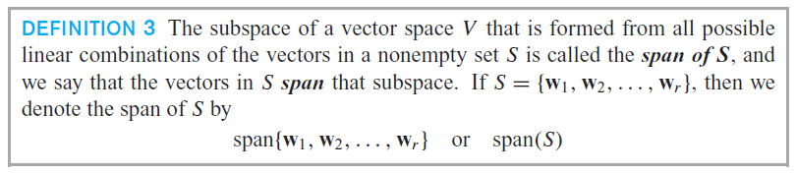
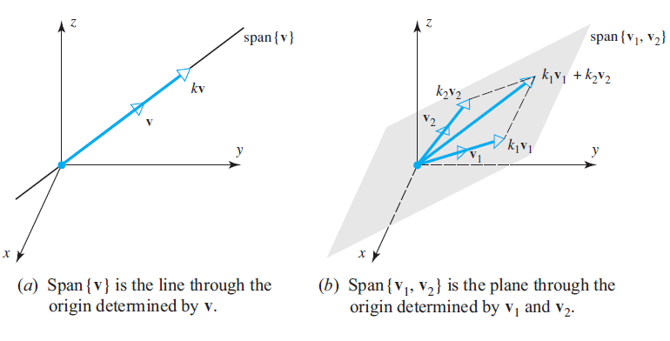
The span of S
Notes:
*

Slide 7
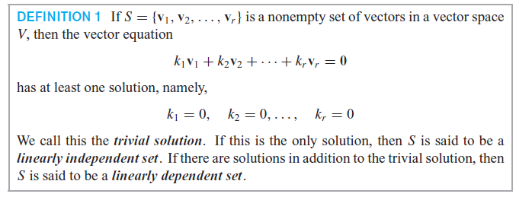
Section 4.3 Linear Independence
Notes:
*

Slide 8
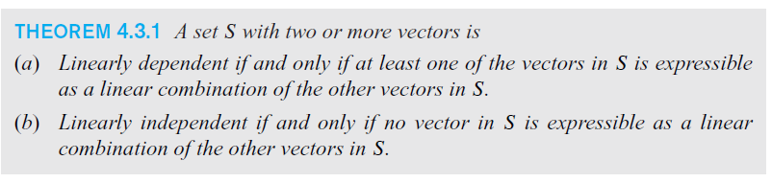
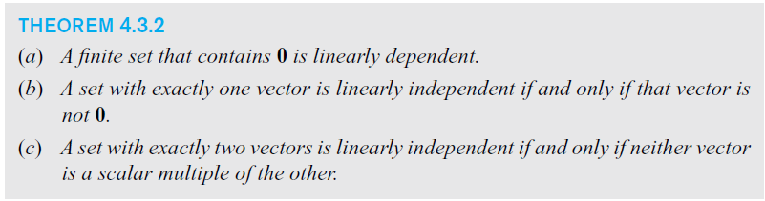
Linearly independence
Notes:
*

Slide 9
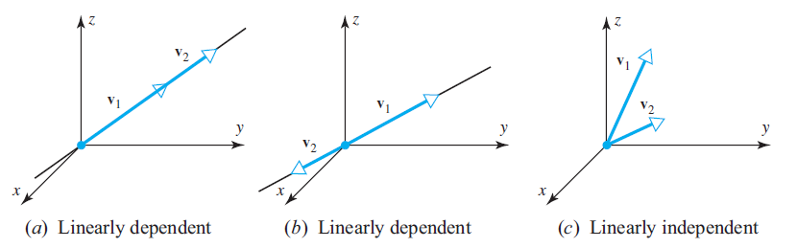
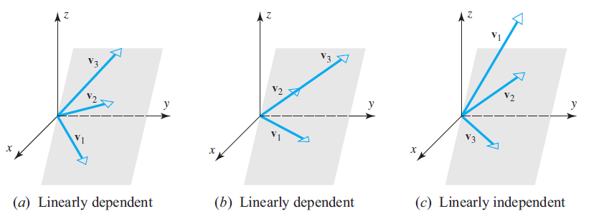
Linear Independence in R² and R³
Notes:
*

Slide 10
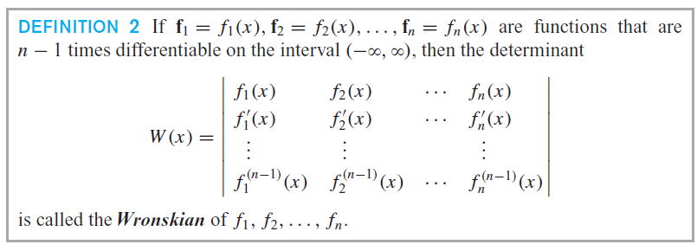
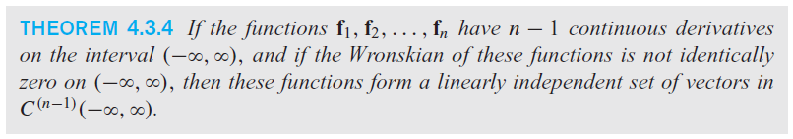
The Wronskian
Notes:
*

Slide 11
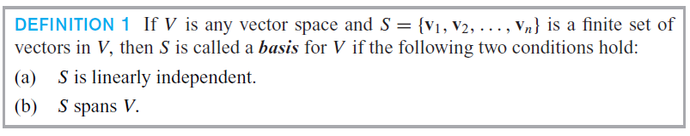
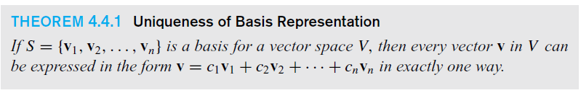
Section 4.4 Coordinates and Basis
Notes:
*

Slide 12
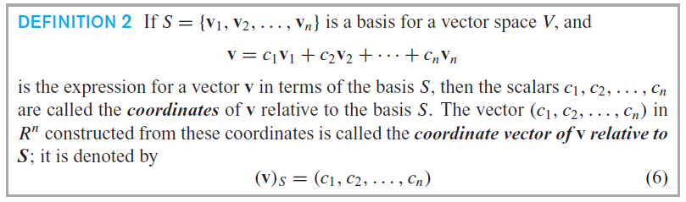
The coordinate vector
Notes:
*

Slide 13
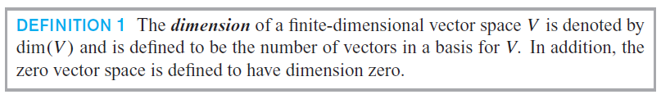
Section 4.5 Dimension
Notes:
*

Slide 14
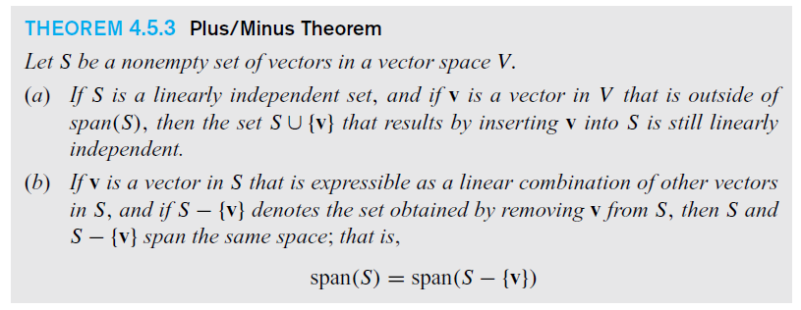
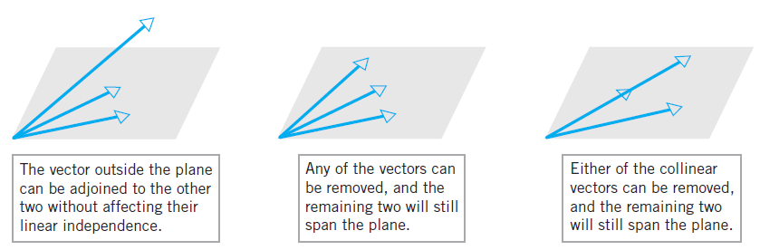
Plus / Minus Theorem
Notes:
*

Slide 15
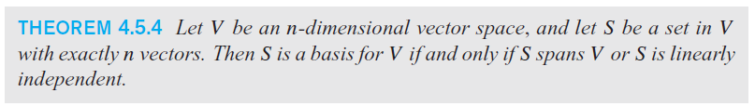
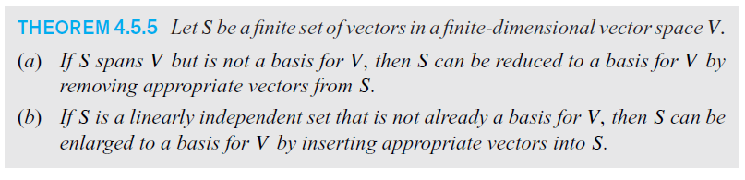
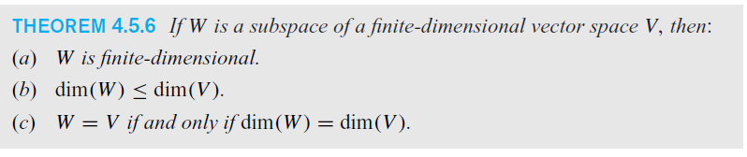
Notes:
*

Slide 16
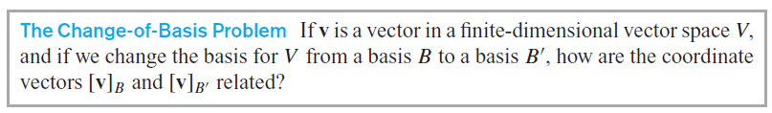
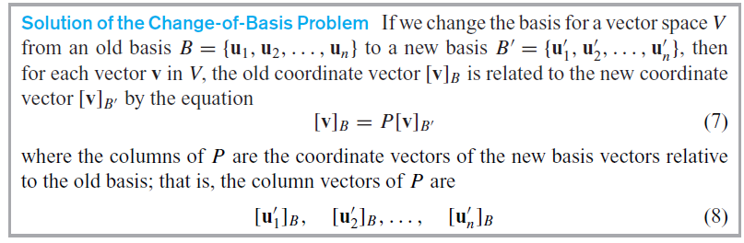
Section 4.6 Change of Basis
Notes:
*

Slide 17

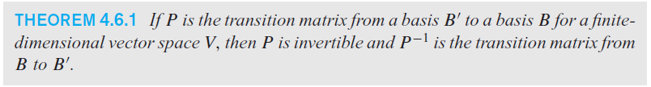
Transition Matrices
Notes:
*

Slide 18
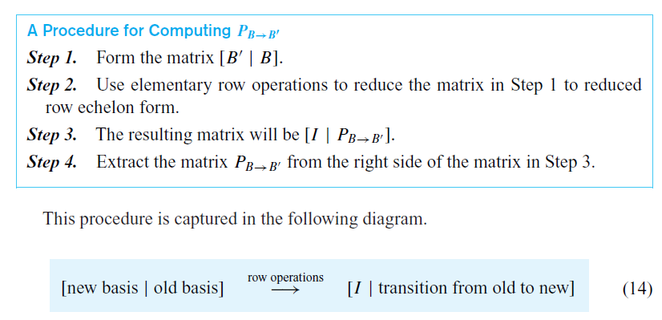
Computing the transition matrix
Notes:
*

